Slide 1
When Do Purchase Precondition Promotions Work?
The Role of External Reference Points
The Knowledge, Information and Innovation Research Group
Guanzhong Du David Hardisty
Funded by

Slide 2
Guanzhong Du

Slide 3
Imagine that you are the manager of a supermarket. Your supermarket would mail a promotion to 1000 people who live in the local area with a coupon.
$1 Off
Any Product
The Knowledge, Information and Innovation Research Group
How many people do you think would redeem the coupon?

Slide 4
Imagine that you are the manager of a supermarket. Your supermarket would mail a promotion to 1000 people who live in the local area with a coupon.
The Knowledge, Information and Innovation Research Group
$1 Off
Any Product Above $3
How many people do you think would redeem the coupon?

Slide 5
Would the purchase precondition increase promotion effectiveness?
Professionals
in Marketing / Sales
Lay Grocery Shoppers
The Knowledge, Information and Innovation Research Group
12% predicted so
10% predicted so
Notes:
Indeed, purchase preconditions make a promotion objectively worse economically.

Slide 6
The Existing Literature
Purchase preconditions hurt perceived fairness (Gneezy 2005).
Purchase preconditions diminish perceived freedom of choice (Wierich and Zielke 2014).
Deal restrictions are, in general, “promoters of promotions” by accentuating deal value (Inman, Peter, and Raghubir 1997).
Notes:
Deal restrictions can take three different forms (Inman et al. 1997): quantity restrictions (e.g., “$2 off, applicable to no more than five purchases per consumer”), time restrictions (e.g., “$2 off, deal expires in two days”), and purchase preconditions (e.g., “$2 off if you spend $5 or more”).
But the Inman paper does not explain when or why the accentuation effect takes place

Slide 7
Research Question
WHEN and WHY do purchase preconditions influence consumer behavior?

Slide 8
A Novel Insight into Purchase Preconditions
Purchase preconditions as external references points that reset consumers’ discount magnitude calculus

Slide 9
Consumers often judge a price promotion by comparing it to a reference point (Monroe 1973).
External Reference Point
Directly observed pieces of information present in the decision-making environment (Mayhew & Winer 1992)
Precise and objective
Internal Reference Point
Absent in the environment, developed from experience, and based on memory (Biswas et al. 1993)
Flexible and subjective
Notes:
External reference points are observed information (Mayhew and Winer 1992), such as seeing the prices of smartphones on a website, while internal ones are developed from experience and based on memory, such as the prices someone has previously paid for smartphones. People tend to use an internal reference point as a default to evaluate a target unless an external reference point is available (Biswas and Blair 1991). For example, when seeing the price of a smartphone, consumers will judge how expensive it is with respect to previous prices they have seen, unless another smartphone price is immediately at hand for comparison.

Slide 10
ERP vs. IRP
In the absence of an ERP, people tend to use an IRP as a default to evaluate a target.
However, people adjust their reference point accordingly if an ERP is available (Biswas and Blair 1991).

Slide 11
Our Proposition:
Purchase preconditions serve as ERPs
Consider a $2 off promotion for a grocery store, no minimum spending
Discount = $2/IRP = $2/$13 = 15% off
Consider a $2 off promotion for a grocery store, minimum purchase $4
Discount = $2/ERP = $2/$4 = 50% off
Notes:
According to an expenditure survey, IRP grocery store = $13

Slide 12
When a purchase precondition > IRP
It diminishes perceived magnitude of a discount
When a purchase precondition < IRP
It enlarges perceived magnitude of a discount

Slide 13
5
Conceptual Model
Perceived
Discount Magnitude
Consumer
Reactions
Purchase
Precondition

Slide 14
Pilot Study (N = 200)
Are consumers aware of and use store-level IRPs when encountering an unrestricted price discount?
$5 off promotion
for a grocery store
Deal Evaluation = 5.39
$5 off promotion
for a furniture store
Deal Evaluation = 1.97
p < .001

Slide 15
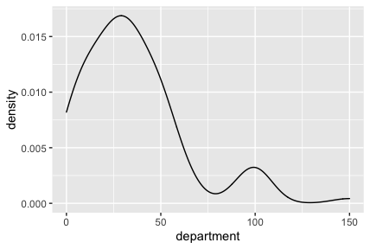
Measuring the Internal Reference Point (Typical Expenditures)
3
Smoothed mode, identified using the maximum kernel density estimate
e.g.,
price
Notes:
Sample graph: UK, department store

Slide 16
Empirical Overview
6
Study 1a
Basic Effect
Study 1b
Study 2
Manipulating the Reference Point: Cutoffs
Study 3
Attenuating the Reference Effect: Percentage Discount
Study 4
Attenuating the Reference Effect: Category Restriction
Study 5
Smaller Restricted Discount vs. Larger Unrestricted Discount

Slide 17
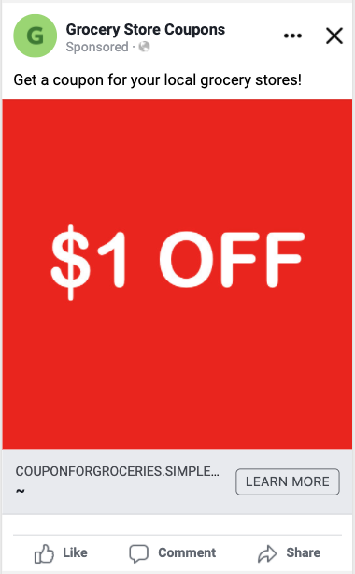
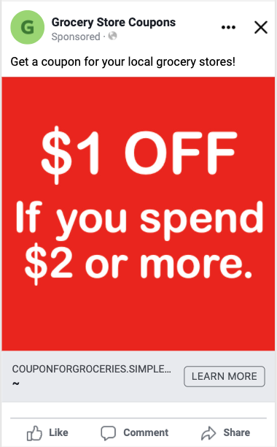
Study 1A Basic Effect (Facebook)
8

Slide 18
9
CTR = 0.88% CTR = 1.13%
p < .001

Slide 19
Study 1B Basic Effect (Controlled Experiment)
10
N = 321 U.S. participants from Prolific
Participants evaluated a coupon for an electronics store
Between-participants
1) Unrestricted: Save $20
2) Restricted: Save $20 on Purchases above $40

Slide 20
11
DV: Deal Evaluations
“To what extent do you think this offer is a good deal?”
(1= not at all, 7 = very much)
Unrestricted Restricted
M = 5.17 < M = 6.06 SD = 1.30 SD = .97
p < .001

Slide 21
Study 2 Manipulating the Reference Point-Cutoff
12
N = 300 U.K. participants from Prolific
Imagine that you find a coupon in a flyer for a supermarket
Between-participants
1) Unrestricted:
“£1 off” promotion
2) Restricted, Low cutoff——below the IRP:
“£1 off any product above £2” promotion
3) Restricted, High cutoff——above the IRP:
“£1 off any product above £20” promotion

Slide 22
Study 2 Manipulating the Reference Point-Cutoff
12
N = 300 U.K. participants from Prolific
Imagine that you find a coupon in a flyer for a supermarket
Between-participants
1) Unrestricted:
“£1 off” promotion
2) Restricted, Low cutoff——below the IRP:
“£1 off any product above £2” promotion 50% OFF
3) Restricted, High cutoff——above the IRP:
“£1 off any product above £20” promotion 5% OFF

Slide 23
14
Mediator: Perceived Magnitude of the Discount
“In your opinion, how large is this discount?”
1 = very small
7 = very big
DV: Redemption Intention
“How likely are you to redeem this coupon?”
1 = very unlikely
7 = very likely

Slide 24
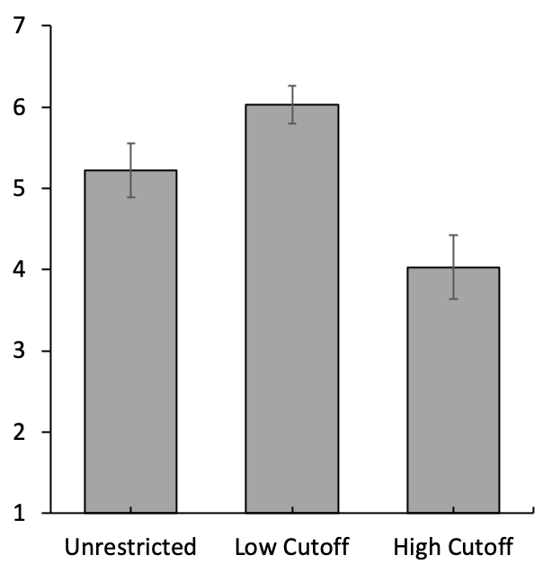
DV: Redemption Intention (Mean)
p < .001
p < .001
Error Bars = 95% CI
One-way ANOVA:
F (2, 300) = 36.54
p < .001

Slide 25
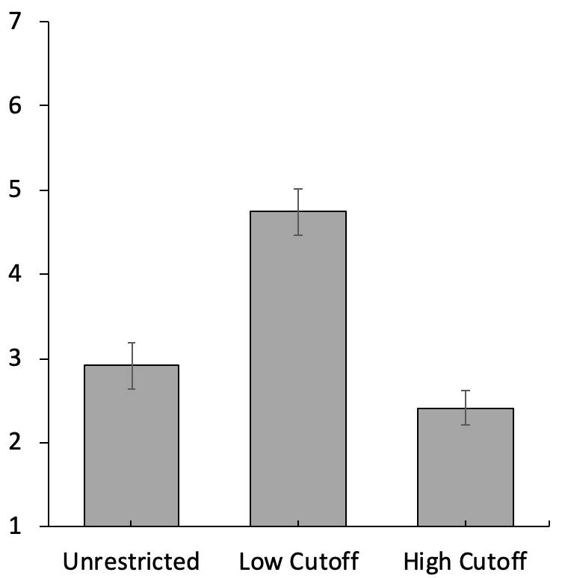
Mediator: Perceived Magnitude of the Discount (Mean)
p < .001
p < .001
Error Bars = 95% CI
One-way ANOVA:
F (2, 300) = 389.72
p < .001
Indirect Effect:
low cutoff vs. no restriction 95% CI = [.53, 1.20]
low cutoff vs. high cutoff
95% CI = [-1.73, -.83]

Slide 26
Study 3 Attenuating the Reference Effect – Percentage Discount
N = 400 U.K. participants from Prolific
Imagine that you find a coupon in a flyer for a department store near where you live
2 × 2 Between-participants
Discount format:
Absolute (£2 off any purchase) vs. Percentage (10% off any purchase)
Purchase precondition:
Unrestricted vs. Restricted (minimum purchase £3)

Slide 27
Mediator: Perceived magnitude of the discount
“In your opinion, how large is this discount?”
1 = very small
7 = very big
DV: Redemption Intention
“How likely are you to redeem this coupon?”
1 = very unlikely
7 = very likely

Slide 28
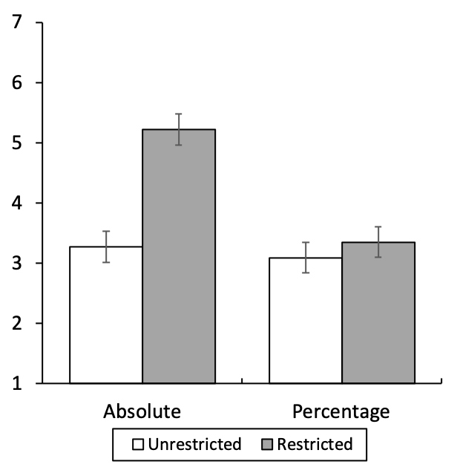
DV: Redemption Intention (Mean)
p = .003
NS
Error Bars = 95% CI
Interaction:
F (1, 396) = 9.14
p = .003

Slide 29
Mediator: Perceived Magnitude of the Discount (Mean)
p < .001
NS
Error Bars = 95% CI
Interaction:
F (1, 396) = 41.54
p < .001

Slide 30
Moderated Mediation
Discount Format
Perceived Magnitude
Precondition
Likelihood of Redemption
Significant Moderated Mediation (Model 7)
Absolute Format: Significant Mediation, 95% CI = [.81, 1.38]
Percentage Format: No Mediation, 95% CI = [-.16, .28]
Notes:
Notably, this study rules out several alternative explanations. For example, it could be argued that a purchase precondition draws consumers’ attention to the offer or makes the offer appear scarce, thus creating the perception that the discount is of higher value. Or, it could be argued that the purchase precondition makes consumers think of a specific product, improving the imaginability of the potential purchase and thereby making it more attractive. However, had the phenomenon been driven by these alternative explanations, the purchase precondition in this study should have boosted perceived discount magnitude and coupon redemption intentions in both the absolute and relative format conditions.

Slide 31
Study 4 Attenuating the Reference Effect – Category Restriction
Category restrictions as implicit ERPs
N = 1307 U.S. participants from Prolific
2 × 2 Between-participants: “$1 Off” Supermarket Coupon
Purchase precondition:
Unrestricted vs. Restricted (above $2)
Equivalent category restriction:
Unrestricted vs. Restricted (a bottle of juice, 12 oz)
Notes:
According to US government data, average price of 12oz of juice = $2

Slide 32
Mediator: Perceived magnitude of the discount
“In your opinion, how large is this discount?”
1 = very small
7 = very big
DV: Redemption Intention
“How likely are you to redeem this coupon?”
1 = very unlikely
7 = very likely

Slide 33
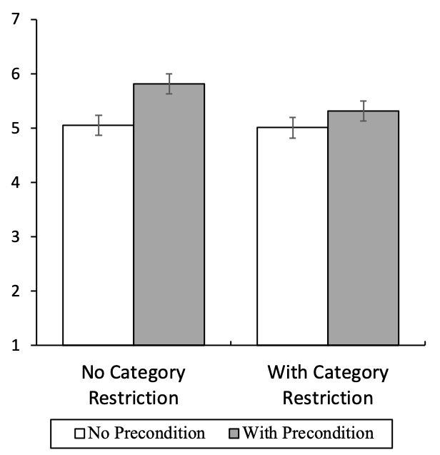
DV: Redemption Intention (Mean)
p < .001
p = .02
Error Bars = 95% CI
Interaction:
F (1, 1303) = 5.98
p = .02

Slide 34
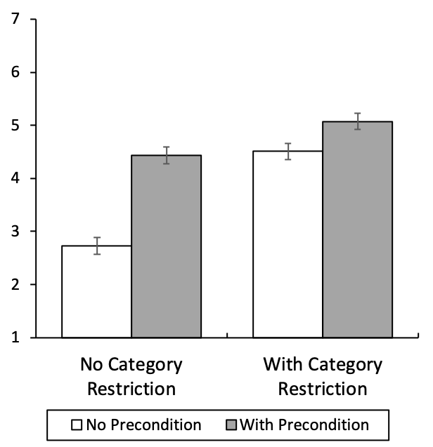
Mediator: Perceived Magnitude of the Discount (Mean)
p < .001
p < .001
Error Bars = 95% CI
Interaction:
F (1, 1303) = 52.21
p < .001

Slide 35
Moderated Mediation
Equivalent
Category Restriction
Perceived Magnitude
Precondition
Likelihood of Redemption
Significant Moderated Mediation (Model 7)
Without Category Restriction: Indirect Effect = .66, 95% CI = [.53, .81]
With Category Restriction: (Attenuated) Indirect Effect = .22, 95% CI = [.14, .31]

Slide 36
Study 5 Smaller Restricted Discount vs. Larger Unrestricted Discount
If a purchase precondition acts as an ERP that biases perceptions of discount magnitude
➣ Consumers may find a restricted price discount that offers a lower dollar discount more attractive than an unrestricted price discount that provides a higher dollar discount
Notes:
We also test a managerially relevant moderator: joint/ separate. Retailers sometimes advertise several price promotions together, and different retailers may advertise their price promotions through the same channel.

Slide 37
Study 5 Smaller Restricted Discount vs. Larger Unrestricted Discount
N = 750 U.S. participants from Prolific
Between Participants: Supermarket Coupon
1) Separate evaluation, unrestricted
“$2 off” promotion for a supermarket
2) Separate evaluation, restricted
“$1 off any product above $2” promotion for a supermarket
3) Joint evaluation

Slide 38
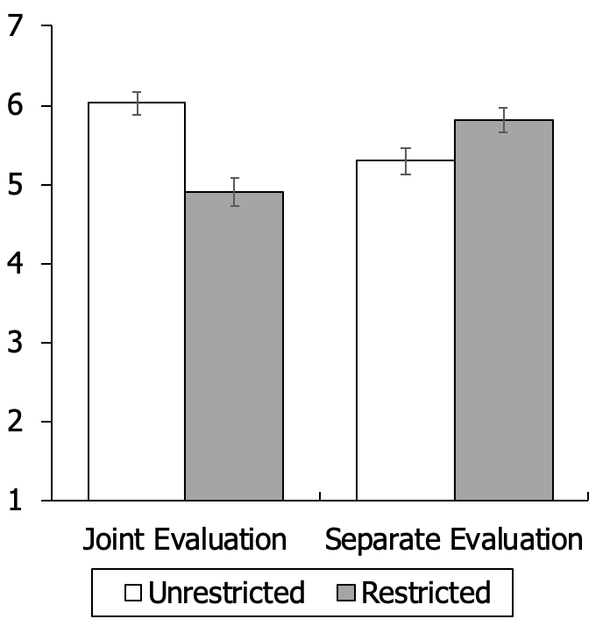
DV: Deal Evaluation
p < .001
p < .001
Error Bars = 95% CI
Reversal:
t (762) = 11.14
p < .001

Slide 39
Contributions
A new lens for understanding purchase preconditions: ERPs that affect the magnitude of a discount as perceived by consumers.
An externally supplied reference point can generate more positive consumer reactions even when it makes the offer objectively worse economically——a novel dominance violation.

Slide 40
Thank you!

Slide 41
Alternative Explanation Mere Evaluability Effect?
Note that a target being easier to evaluate does not imply it would be judged to be larger in magnitude.
Supplemental Study: evaluability as a covariate.
Notes:
Since we argue that a purchase precondition serves as a reference point, it could be asked whether the basic phenomenon merely reflects an increase in the evaluability (i.e., how hard it is to evaluate a target; Hsee 1996) of the discount. Indeed, introducing a reference point can make a target easier to be evaluated, but increased evaluability alone is not a sufficient explanation for the phenomenon because a target being easier to evaluate does not imply it would be judged to be larger in magnitude. To further demonstrate that the basic phenomenon is not a mere evaluability effect, we conducted a supplemental study, in which we measured evaluability, used it as a covariate, and replicated the basic effect and mediation.

